Slide 1
CSE 440
Artificial Intelligence
AI Agents
Dr. Mohammad Mahmudul Alam
Department of Electrical & Computer Engineering (ECE)
North South University (NSU)

Slide 2
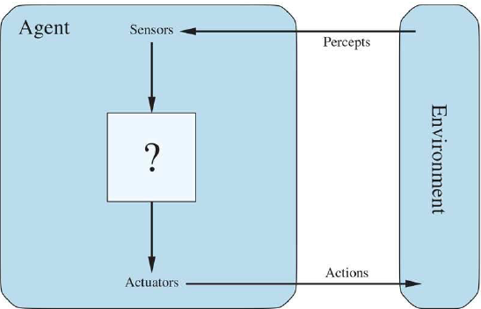
What is an Agent?
An agent is anything that can be viewed as perceiving its environment through sensors and acting upon that environment through actuators.
Broadly: A thing that does something, with agency.

Slide 3
Human as Agent
Percepts | Actions
Eyes, ears, other sensory organs to percept the environment | Hands, legs, vocal tract as actuators for any actions on the environment

Slide 4
A Robotic Agent
Percepts | Actions
Percepts | Actions
Cameras, infrared to percept the environment | Various motors for actuators to act on the environment

Slide 5
A Software Agent
Percepts | Actions
Percepts | Actions
File content, receive network packets, human inputs | Writing files, send network packets, display information or play a sound

Slide 6
A Rational Agent
A rational agent is one that does the right thing. Obviously, doing the right thing is better than doing the wrong thing, but what does it mean to do the right thing?
What is rational at any given time depends on four things:
The performance measure that defines the criterion of success.
The agent’s prior knowledge of the environment.
The actions that the agent can perform.
The agent’s percept sequence to date.

Slide 7
A Rational Agent Example
Imagine a vacuum-cleaner robotic agent attempting to clean a room. At each time step it can clean a square foot.
The performance measure that defines the criterion of success. Square footage of dirt cleaned by the agent.
The agent’s prior knowledge of the environment. Agent need to know about the environment/geography but not necessary a priori knowledge of the dirt location.
The actions that the agent can perform. Must have actuators to move left, right, forward, and clean up dirt.
The agent’s percept sequence to date. Agent must be able to correctly perceive its location and the location of the dirt.

Slide 8
PEAS
Therefore, An Agents must have:
Performance measure
Environment
Actuators
Sensors
In designing an agent, the first step must always be to specify the task environment as fully as possible.

Slide 9
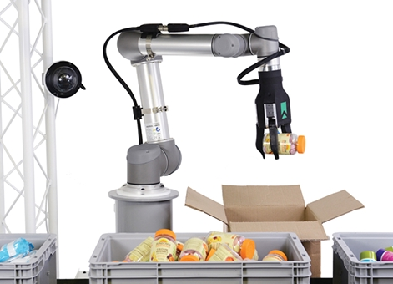
PEAS Example
Performance measure:
Environment:
Actuators:
Sensors:
Part-picking robot:
Performance measure: Percentage of parts in correct bins
Environment: Conveyor belt with parts, bins
Actuators: Jointed arm and hand
Sensors: Camera, joint angle sensors

Slide 10

PEAS Example
Performance measure:
Environment:
Actuators:
Sensors:
Interactive English tutor:
Performance measure: Maximize student’s score on test
Environment: Set of students
Actuators: Screen display (exercises, suggestions, corrections)
Sensors: Keyboard, Microphone

Slide 11
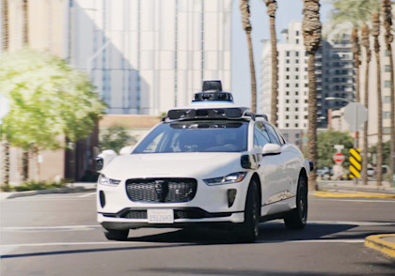
PEAS Example
Performance measure:
Environment:
Actuators:
Sensors:
Automated Taxi:
Performance measure: Safe, fast, legal trip, maximize profit
Environment: Road, traffic, police, pedestrians, weather
Actuators: Steering, accelerator, brake, signals, display, sound
Sensors: Cameras, radar, speedometer, GPS, engine, and more

Slide 12
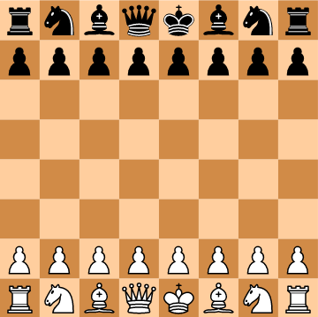
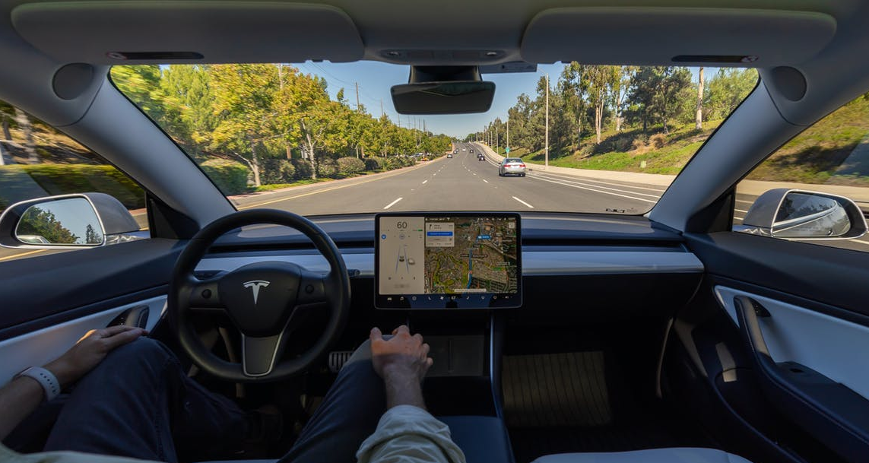
Properties of Environment
Fully Observable vs. Partially Observable:
If an agent’s sensors give it access to the complete state of the environment at each point in time, then we say that the environment is fully observable.
A task environment is effectively fully observable if the sensors detect all aspects that are relevant to the choice of action
If the agent has no sensors at all then the environment is unobservable.

Slide 13
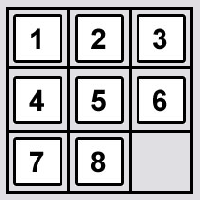
Properties of Environment
Single Agent vs. Multi Agent:
Single Agent Environment: Only agent in the environment
Multi Agent Environment: An agent compete or cooperate with other existing agents in the environment

Slide 14
Properties of Environment
Deterministic vs. Non-deterministic (Stochastic):
If the next state of the environment is completely determined by the current state and the action executed by the agent(s), then we say the environment is deterministic.
Otherwise, it is nondeterministic.
Chess
Deterministic
Dice Games
Non-deterministic
Tic-Tac-Toe
Deterministic
Self-driving Car
Non-deterministic

Slide 15
Properties of Environment
Episodic vs. Sequential:
Episodic environments are those where each action is independent of the next.
While sequential environments are those where the current action affects the next state.
Episodic Environment:
Image Classification: Each image is classified independently without considering previous results.
Tetris: Each game round is separate, and the agent doesn’t need to consider the next round.
Sequential Environment:
Chess: Each move changes the board state and influences future decisions.
Robot Navigation: The agent’s movements in one location impact its future positioning and interactions.

Slide 16
Properties of Environment
Static vs. Dynamic:
If the environment can change while an agent is deliberating (considering), we say the environment is dynamic for that agent.
Otherwise, it is static.
A static environment does not change while the agent is thinking.
The passage of time as an agent deliberates is irrelevant.
The agent doesn’t need to observe the world during deliberation.

Slide 17
Properties of Environment
Discrete vs. Continuous:
If the number of distinct percepts and actions is limited, the environment is discrete, otherwise it is continuous.
Receives percepts describing the world one at a time.
Maps this percept sequence to a sequence of discrete actions.

Slide 18
Characteristics of Environments
Task | Observable | Deterministic | Episodic | Static | Discrete | Agents
Solitaire
Chess
Taxi Driving
Internet shopping
Medical Diagnosis
Crossword Puzzle

Slide 19
Characteristics of Environments
Task | Observable | Deterministic | Episodic | Static | Discrete | Agents
Solitaire | No | Yes | Yes | Yes | Yes | Single
Chess
Taxi Driving
Internet shopping
Medical Diagnosis
Crossword Puzzle

Slide 20
Characteristics of Environments
Task | Observable | Deterministic | Episodic | Static | Discrete | Agents
Solitaire | No | Yes | Yes | Yes | Yes | Single
Chess | Yes | Yes | Yes | Yes | Yes | Multi
Taxi Driving
Internet shopping
Medical Diagnosis
Crossword Puzzle

Slide 21
Characteristics of Environments
Task | Observable | Deterministic | Episodic | Static | Discrete | Agents
Solitaire | No | Yes | Yes | Yes | Yes | Single
Chess | Yes | Yes | Yes | Yes | Yes | Multi
Taxi Driving | No | No | No | No | No | Multi
Internet shopping
Medical Diagnosis
Crossword Puzzle

Slide 22
Characteristics of Environments
Task | Observable | Deterministic | Episodic | Static | Discrete | Agents
Solitaire | No | Yes | Yes | Yes | Yes | Single
Chess | Yes | Yes | Yes | Yes | Yes | Multi
Taxi Driving | No | No | No | No | No | Multi
Internet shopping | No | No | No | No | No | Multi
Medical Diagnosis
Crossword Puzzle

Slide 23
Characteristics of Environments
Task | Observable | Deterministic | Episodic | Static | Discrete | Agents
Solitaire | No | Yes | Yes | Yes | Yes | Single
Chess | Yes | Yes | Yes | Yes | Yes | Multi
Taxi Driving | No | No | No | No | No | Multi
Internet shopping | No | No | No | No | No | Multi
Medical Diagnosis | No | No | No | No | No | Single
Crossword Puzzle

Slide 24
Characteristics of Environments
Task | Observable | Deterministic | Episodic | Static | Discrete | Agents
Solitaire | No | Yes | Yes | Yes | Yes | Single
Chess | Yes | Yes | Yes | Yes | Yes | Multi
Taxi Driving | No | No | No | No | No | Multi
Internet shopping | No | No | No | No | No | Multi
Medical Diagnosis | No | No | No | No | No | Single
Crossword Puzzle | Yes | Yes | No | Yes | Yes | Single

Slide 25
Structure of Agents
Four basic kinds of agent programs embody the principles underlying almost all intelligent systems:
Simple reflex agents;
Model-based reflex agents;
Goal-based agents;
Utility-based agents;

Slide 26
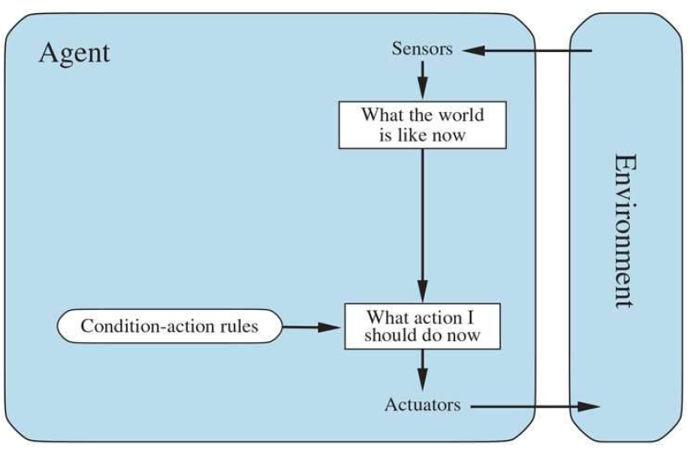
Simple Reflex Agents
The simplest kind of agent is the simple reflex agent.
Select actions on the basis of the current percept, ignoring the rest of the percept history.
Ex: Chess, Checkers, Tic-Tac-Toe.

Slide 27
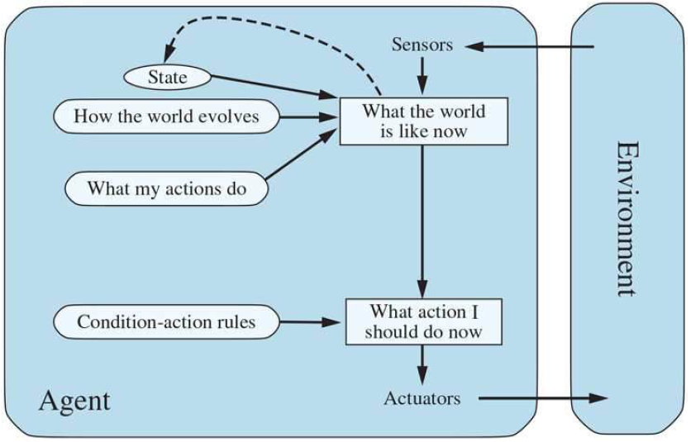
Model-based Reflex Agents
The most effective way to handle partial observability environment.
Keeps track of the part of the world it can’t see now.
Ex: Self-driving car, Vacuum cleaning robot.

Slide 28
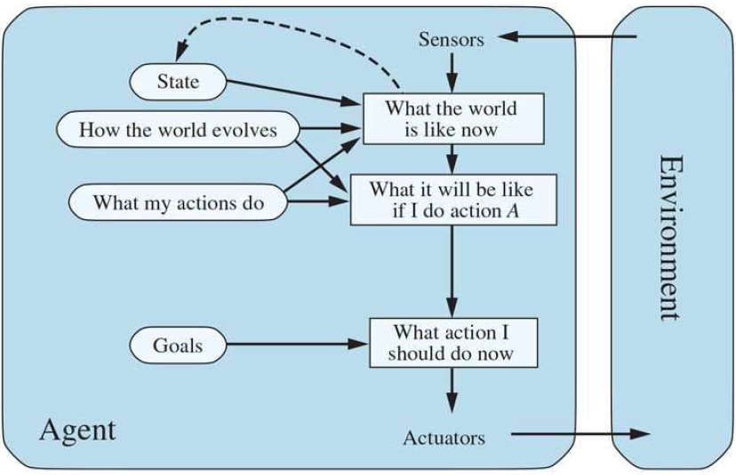
Goal-based Agents
Agent needs some sort of goal information that describes situations that are desirable.
Agent program can combine this with the model information to choose actions that achieve the goal.

Slide 29
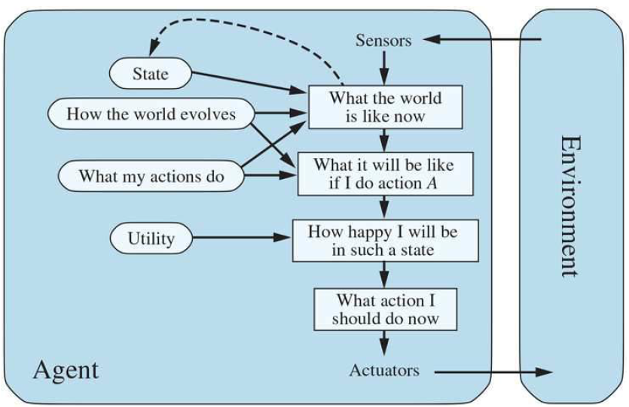
Utility-based Agents
Goals alone are not enough to generate high-quality behavior in most environments.
For example, many action sequences will get a taxi to its destination, but some are quicker, safer, more reliable, or cheaper than others.
Agent’s utility is essentially a function of the performance measure.

Slide 30
Reading
Chapter 02 of the textbook
Pages 54 to 74

